Slide 1

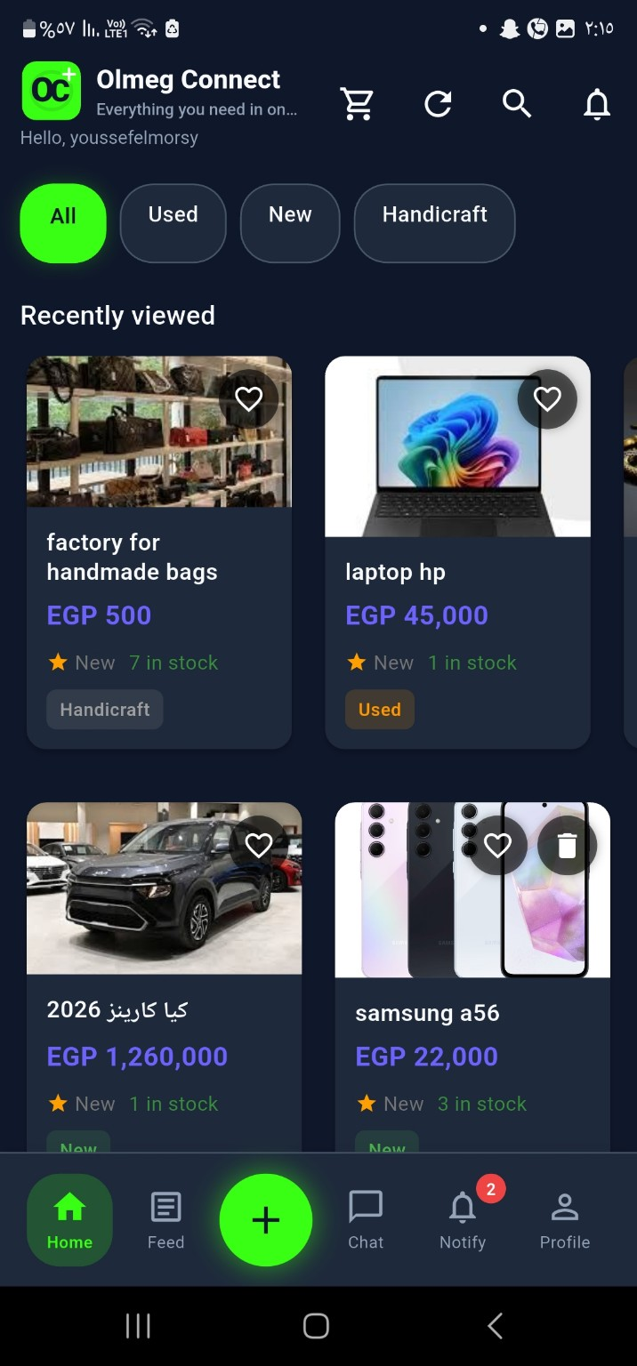
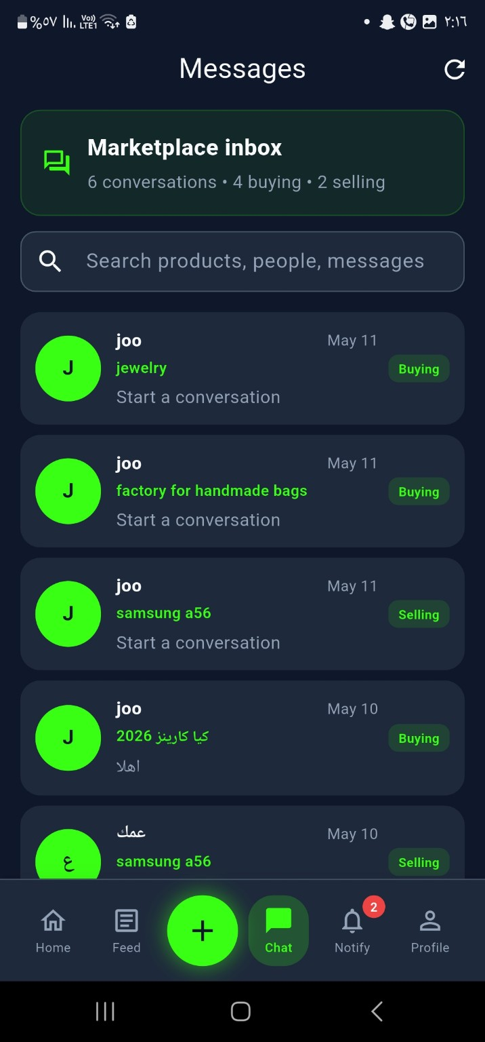
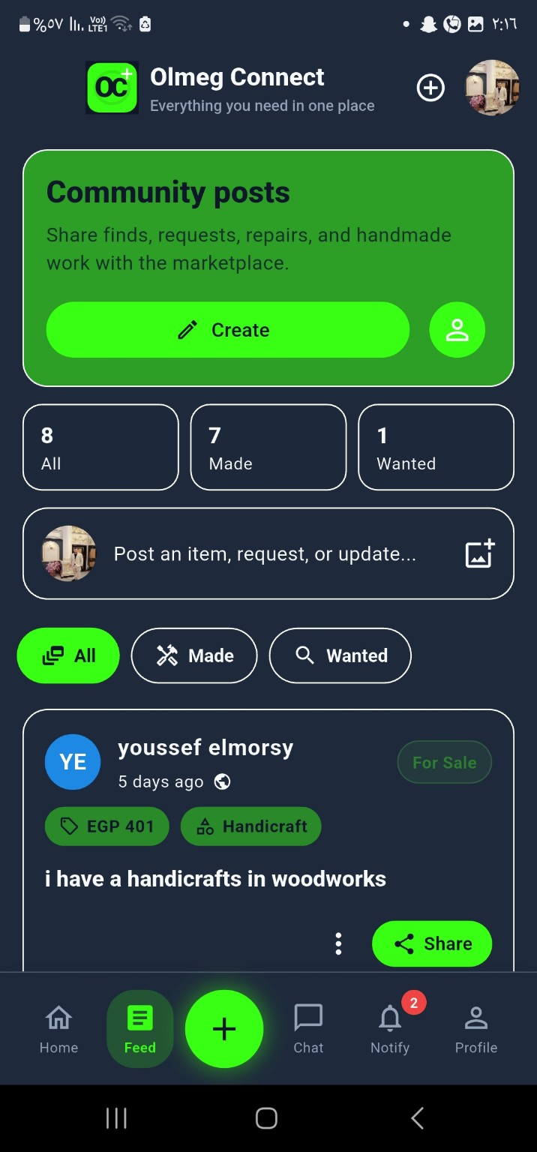
OLMEG CONNECT
Smart Marketplace Platform
Flutter + Firebase app combining marketplace, social feed, chat, notifications, seller tools, and admin moderation.
Marketplace
Chat
Used Products
Handmade
Social Feed
New Products
Everything you need in one place
EELU Graduation Project • 2026

Slide 2
Project Identity
OLMEG CONNECT
Egyptian E-Learning University • Faculty of Computers & Information Technology
Supervision
Team Members
Dr. Asmaa Hekal
Eng. Mohamed Saied
• Youssef Hafez El Morsy — 2200028
• Merna Mohamed Naeim — 2201804
• Mina Hany Samir — 2202185
• Youssef Abdelmonem Aly — 2201393
• Rayan Ahmed — 2201792
• Abdelrahman Anwar — 2101962
• Mahmoud Haroun — 2100914
• Ehab Ibrahim — 2100611
• Adham Ahmed Hamdy — 2100309
• tarek Mohamed abd elhakim — 2101660
Project Version & Links
Version: 2.1.0
Repository: github.com/Youssef-hafez-elmorsy/OLMEG-Connect
Hosting: olmeg-connect.web.app
Graduation Project • Flutter + Firebase Marketplace
02

Slide 3
Project Vision
OLMEG CONNECT
A unified marketplace ecosystem for buyers, sellers, merchants, and admins
Olmeg Connect transforms a basic shopping app into a complete local commerce platform.
Marketplace
Communication
Community
Moderation
Scalability
New, used, and handmade product discovery with product details, favorites, and search.
Product-linked chat supports direct negotiation between buyers and sellers.
Social feed lets users post products, requests, and marketplace updates.
Admin tools and product moderation improve trust and safety.
Flutter + Firebase architecture supports future production expansion.
Core : “Everything you need in one place.”
Graduation Project • Flutter + Firebase Marketplace
03

Slide 4
Problem Statement
OLMEG CONNECT
Why Olmeg Connect is needed
01
Fragmented platforms
02
Weak moderation
Users switch between apps for used items, handmade products, and new products.
Unsafe, fake, or inappropriate listings reduce trust in marketplaces.
03
Poor communication
04
Limited admin control
Many platforms do not provide clear, product-linked chat flows.
Lack of structured reports and moderation slows platform management.
Graduation Project • Flutter + Firebase Marketplace
04

Slide 5
Solution Ecosystem
OLMEG CONNECT
One app connecting roles, content, and backend services
Products
Posts
Chats
Notifications
Buyer
Browse • Search • Chat • Review
Seller / Merchant
List • Manage • Orders
Auth
Storage
Olmeg
Connect
Community
Posts • Reactions • Sharing
Admin
Moderate • Notify • Verify
Graduation Project • Flutter + Firebase Marketplace
05

Slide 6
User Journeys
OLMEG CONNECT
Guest, buyer, seller, and admin workflows
Guest
Open app
Login / Register
Choose account type
Buyer
Browse / Search
Open product
Chat seller
Review / favorite
Seller
Add product
Moderation check
Published / queued
Manage inventory
Admin
Review submissions
Approve / reject
Send notifications
Handle reports
Graduation Project • Flutter + Firebase Marketplace
06

Slide 7
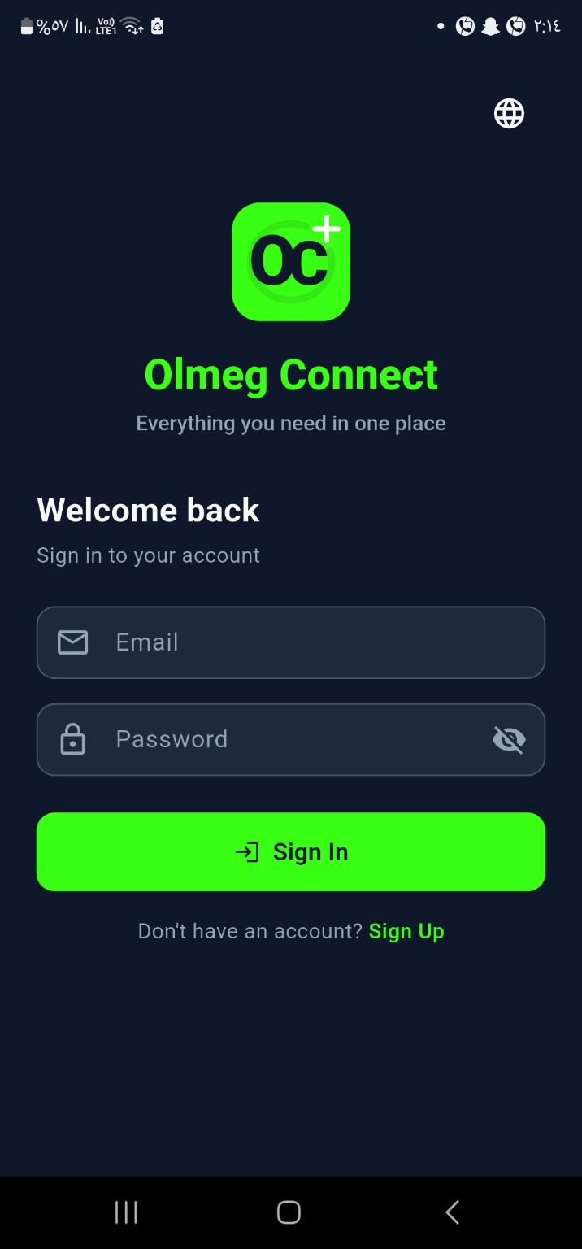

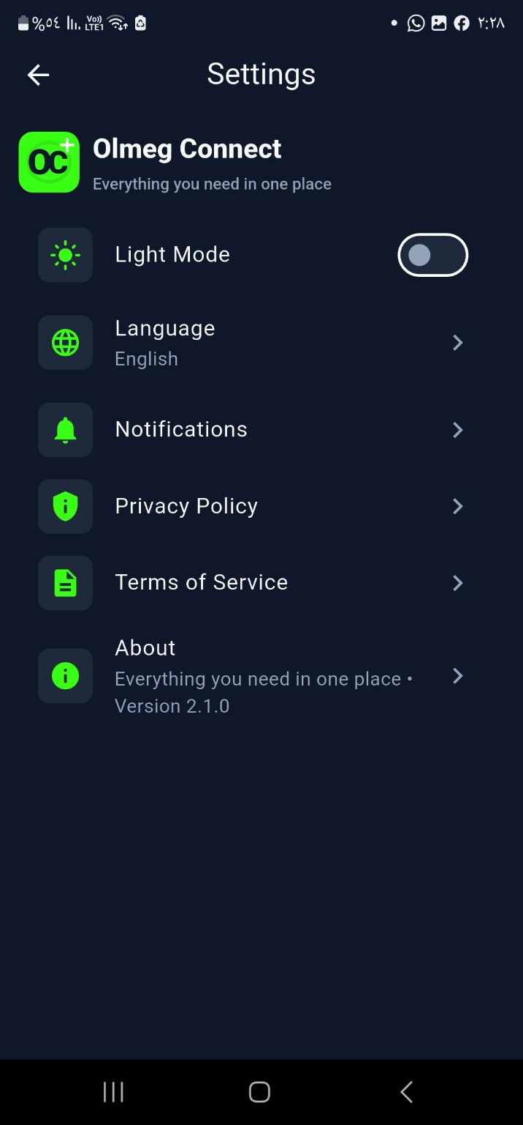
UI / UX Design Language
OLMEG CONNECT
Dark modern marketplace interface with neon green identity
Design System
• Deep dark backgrounds for premium marketplace feel
• Neon green accent for identity and CTAs
• Rounded cards and reusable components
• Bottom navigation shell for quick access
• English + Arabic localization support
• Light/Dark mode setting prepared
Login EN
Arabic RTL
Settings
90%
EN + AR
UI / UX Completion
Languages
Graduation Project • Flutter + Firebase Marketplace
07

Slide 8
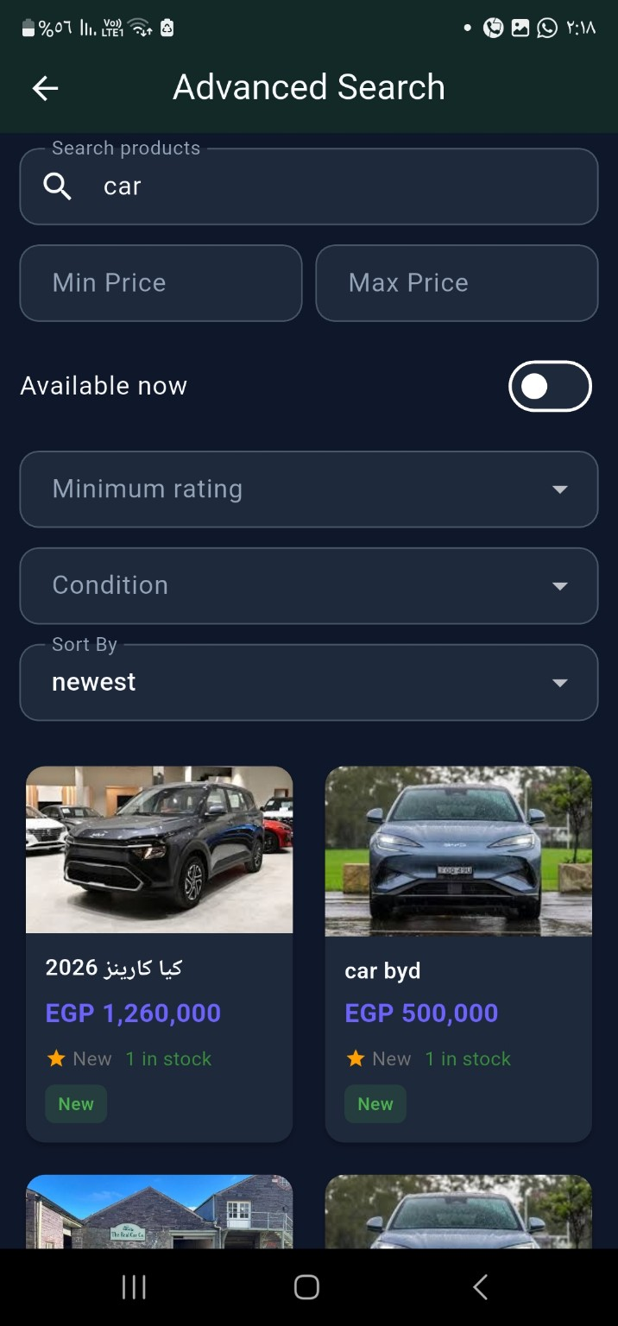
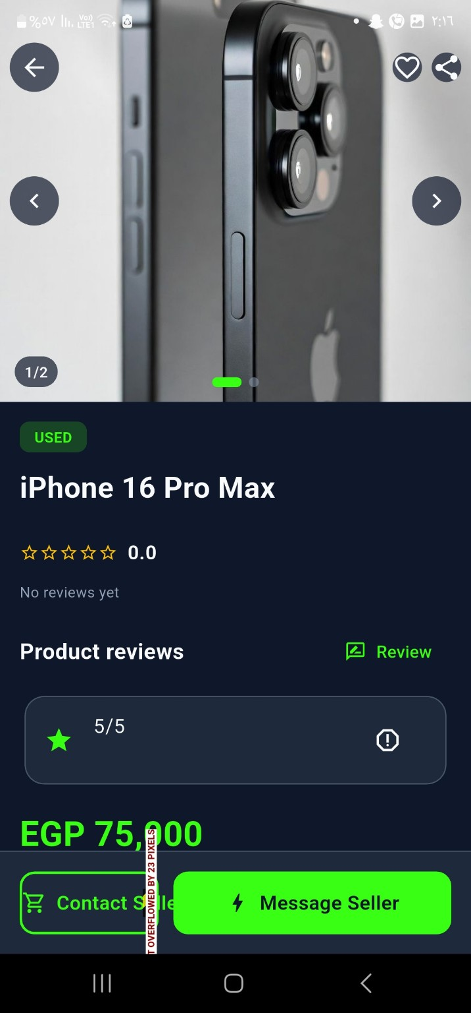
Marketplace & Search
OLMEG CONNECT
Product discovery built for fast browsing and filtering
Implemented
• New / Used / Handmade sections
• Recently viewed products
• Advanced search filters
• Minimum and maximum price
• Availability and condition filters
• Ratings and related products
• Product seller contact options
Home
Advanced Search
Product Details
Graduation Project • Flutter + Firebase Marketplace
08

Slide 9
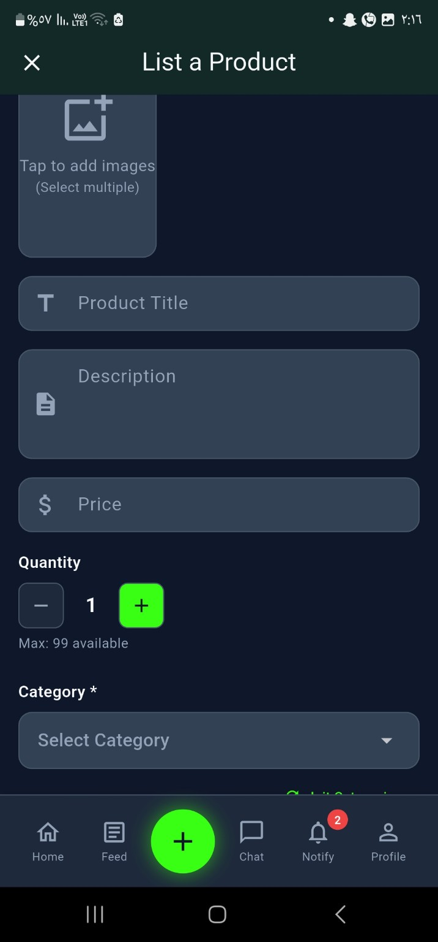
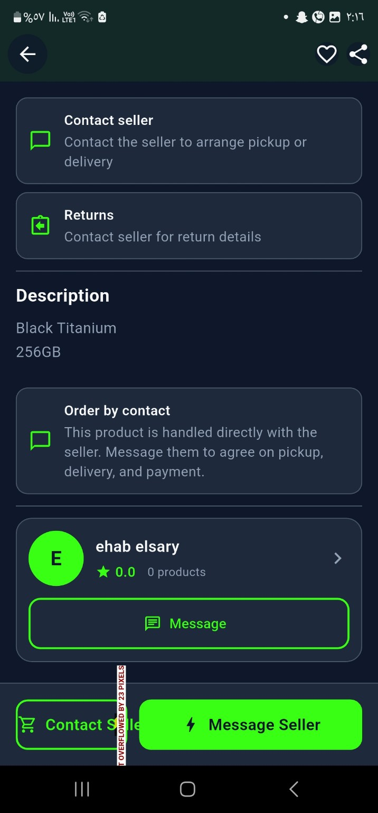
Product Publishing Workflow
OLMEG CONNECT
From seller submission to moderated marketplace listing
Seller
Adds Product
Rule-based
Moderation
Firestore
products / submissions
Admin
Approve / Reject
Moderation checks title quality, description length, pricing validity, unsafe keywords, counterfeit/stolen content, weapons, drugs, hacking, and explosives terms.
Ai moderation
List Product
Seller Contact
Graduation Project • Flutter + Firebase Marketplace
09

Slide 10
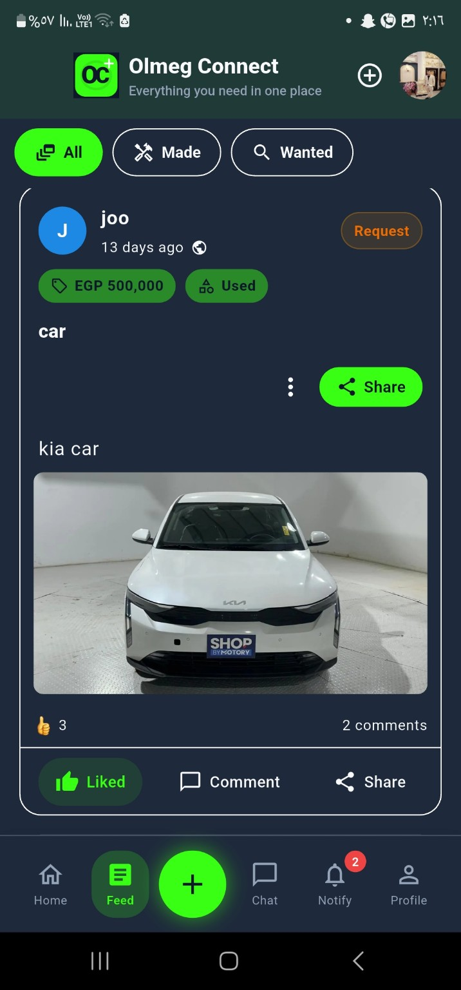
Social Marketplace Layer
OLMEG CONNECT
Community posts turn the marketplace into an engagement platform
Why this matters
The feed allows users to share items, requests, repairs, handmade work, and marketplace updates. This creates a social-commerce experience rather than a simple product catalog.
Features: posts, images, comments, reactions, shares, filters for All / Made / Wanted, and profile-linked post cards.
Community Posts
Post Details
Graduation Project • Flutter + Firebase Marketplace
10

Slide 11
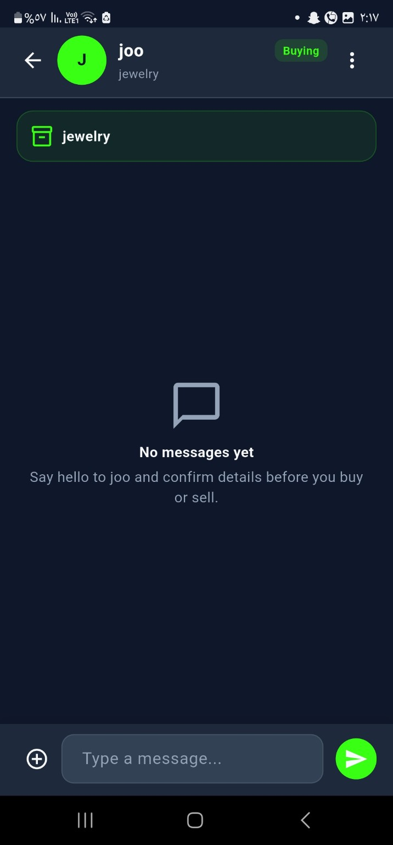
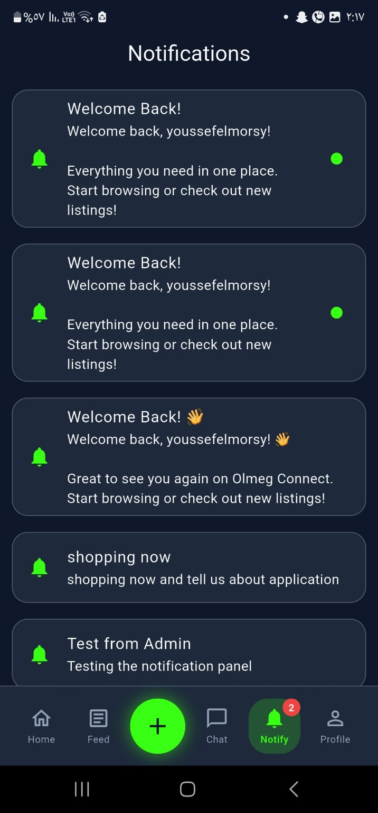
Real-time Communication
OLMEG CONNECT
Chat and notifications keep buyers, sellers, and admins connected
Communication Engine
• Marketplace inbox groups buying and selling conversations
• Product-linked chat improves negotiation context
• Firebase Cloud Messaging supports notification delivery
• Admin broadcasts can notify platform users
• Chat progress is around 80%
Inbox
Chat Detail
Notifications
Graduation Project • Flutter + Firebase Marketplace
11

Slide 12
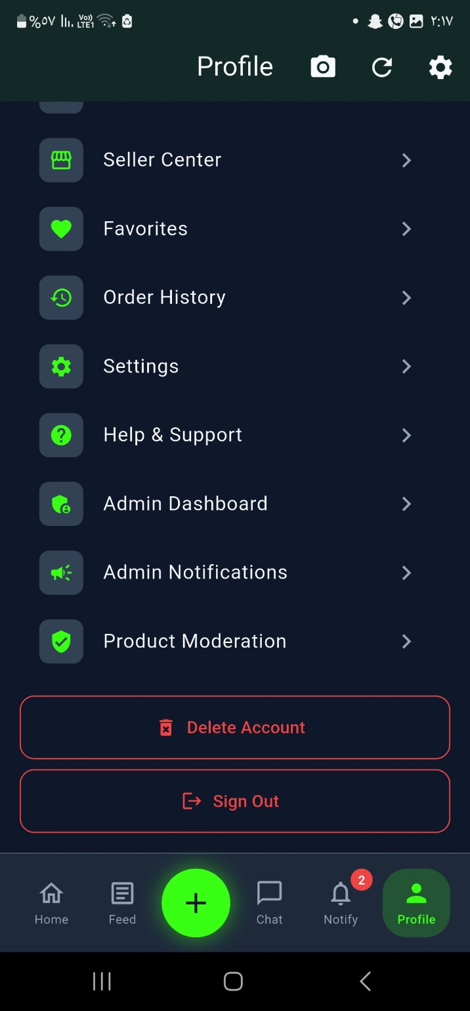
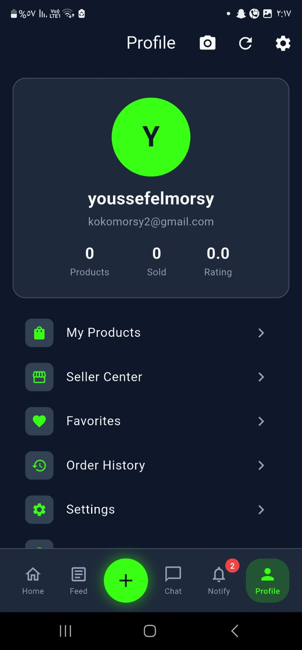
Admin Tools & Platform Safety
OLMEG CONNECT
Role-based controls for moderation, notifications, and reports
Admin-only capabilities
• Admin Dashboard
• Admin Notifications
• Product Moderation
• Reports and content safety
• Merchant verification support
• Account management and sign out
The admin UI is only visible for users with an admin role or admin flag.
Role-based access control
Admin-only profile
Profile
Graduation Project • Flutter + Firebase Marketplace
12

Slide 13
Technology Stack
OLMEG CONNECT
Tools and frameworks used to build the project
Frontend
State & Navigation
Firebase
Packages
• Flutter
• Dart SDK >=3.0.0 <4.0.0
• Material Design
• Custom theme
• English / Arabic localization
• Riverpod
• StateNotifier
• GoRouter
• ProviderScope
• Auth redirects
• Authentication
• Cloud Firestore
• Firebase Storage
• Firebase Messaging
• Firebase Hosting
• image_picker
•cached_network_image
• shimmer
• flutter_paypal
• flutter_rating_bar
Graduation Project • Flutter + Firebase Marketplace
13

Slide 14
Feature-first Architecture
OLMEG CONNECT
Scalable structure using layered feature modules
Flutter UI
Screens + Widgets
Feature Modules
Shared Core
auth
products
cart / orders
chat
posts
notifications
admin
ratings
profile
search
shell
router
services
theme
widgets
localization
utils
errors
constants
Riverpod Providers
State + Business Flow
Repositories + Data Sources
Domain + Data Layers
Firebase Services
Auth • Firestore • Storage • Messaging
Graduation Project • Flutter + Firebase Marketplace
14

Slide 15
Firebase Backend & Data Model
OLMEG CONNECT
Firestore collections supporting the marketplace ecosystem
Users & Access
Marketplace
Commerce
users
• sellerProfiles
• merchant_verifications
products • product_submissions • categories • subcategories • favorites
carts • orders • payments • reviews • ratings
Communication
Social & Analytics
chats
• notifications
• admin_notifications
• reports
posts
• posts/{id}/comments
• analytics_events
Security note: current Firestore and Storage rules are development-friendly and should be hardened before production release.
Graduation Project • Flutter + Firebase Marketplace
15

Slide 16
Testing, Progress & Current Status
OLMEG CONNECT
Implementation maturity based on current codebase and screenshots
Current Progress
Testing Evidence
UI / UX
90%
• Widget smoke test
• Cart total validation
• Order creation tests
• Merchant delivery eligibility tests
• Firebase authentication testing
• Android and web demo testing
• Responsive layout evaluation
Backend / Firebase
90%
Chat System
90%
AI Moderation
70%
Known UI issue identified: product details overflow in one screen. The planned fix is using SafeArea, SingleChildScrollView, and adaptive bottom actions.
Payments
70%
Graduation Project • Flutter + Firebase Marketplace
16

Slide 17
Roadmap & Future Improvements
OLMEG CONNECT
How Olmeg Connect can become production-ready
Now
Next
Future
Core marketplace
Chat 80%
Admin tools
Firebase backend
Full PayPal flow
Security rules
Better responsive UI
Cloud Functions
AI moderation APIs
ML recommendations
Delivery tracking
App Store release
Graduation Project • Flutter + Firebase Marketplace
17

Slide 18
Implementation Matrix
OLMEG CONNECT
Current feature state from repository analysis and live app screenshots
Feature
Status
Evidence / Notes
Authentication
Complete
Login, register, merchant account, admin detection
Marketplace
Complete
Home, product cards, details, categories, favorites
Search
Complete
Search screen, advanced search, filters, sort
Social Feed
Complete
Posts, reactions, comments, sharing
Chat
80%
Product-linked buyer/seller conversations
Notifications
Complete
Notification screen + FCM service
Admin Panel
Complete
Admin dashboard, notifications, moderation access
AI Moderation
60%
Rule-based moderation, future AI API
Payments
40%
PayPal package and payment records, full flow planned
Graduation Project • Flutter + Firebase Marketplace
18

Slide 19
Codebase Structure & Navigation
OLMEG CONNECT
Feature-first Flutter project with protected GoRouter routes
Important Files
Main Routes
• lib/main.dart — app entry point
• lib/firebase_options.dart — FlutterFire config
• lib/core/router/app_router.dart — GoRouter routes
• lib/core/services/notification_service.dart — FCM setup
• firestore.rules — database rules
• storage.rules — media rules
• firebase.json — hosting / functions / rules config
/login /register /home
/product/:id /cart
/create-post /chats /chat/:id
/settings /favorites /my-products
/privacy-policy /terms
/search /advanced-search
/notifications
/admin /admin/notify /admin/moderation
Graduation Project • Flutter + Firebase Marketplace
19

Slide 20
Security & Production Readiness
OLMEG CONNECT
What is implemented now and what must be hardened before release
Current Security
Production Hardening Plan
• Firebase Authentication protects app access
• Router redirects unauthenticated users
• Admin-only UI appears based on user role/admin flag
• Product submissions can be reviewed by admin
• FCM token storage supports personalized notifications
• Restrict product writes to owners
• Restrict admin collections to admins only
• Validate Storage uploads by user path
• Add Cloud Functions for trusted payment validation
• Add report abuse workflow
• Protect merchant verification data
• Audit Firestore indexes and access patterns
Important note: repository rules are currently development-friendly and must be tightened before production.
Graduation Project • Flutter + Firebase Marketplace
20

Slide 21
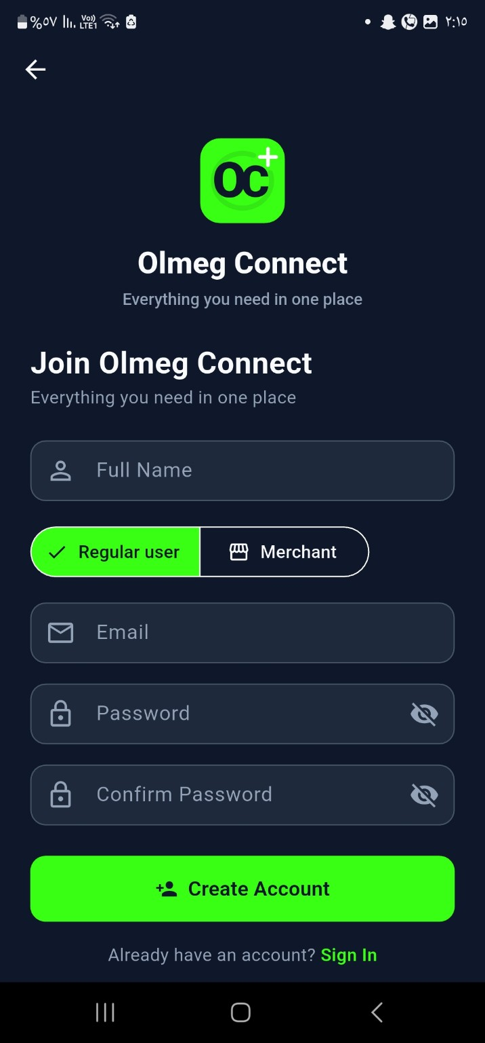
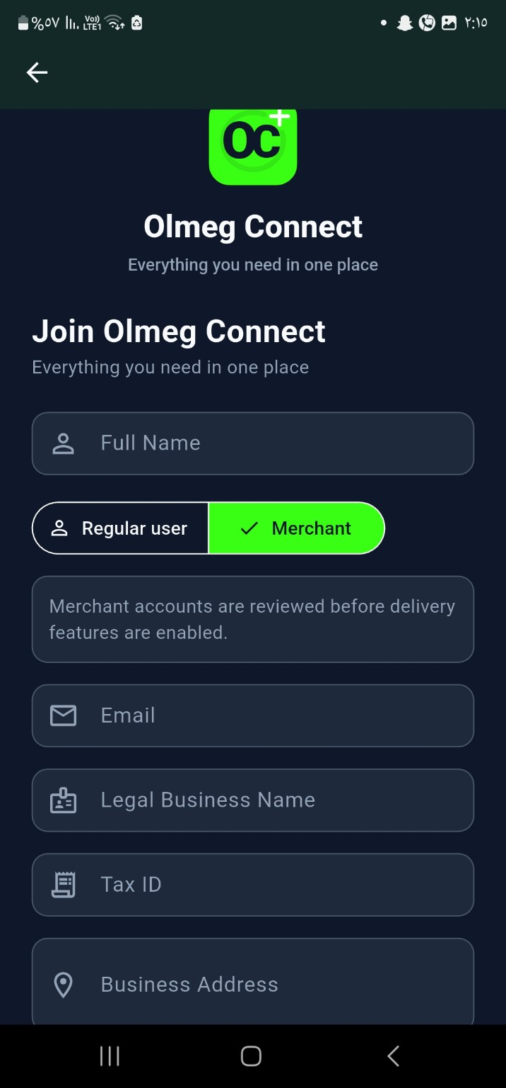
Screenshot Gallery I
OLMEG CONNECT
Authentication, marketplace, search, and product publishing screens
Login EN
Login AR
Register
Merchant
Login EN
Login AR
Register
Merchant
Home
Search
Add Product
Details
Home
Search
Add Product
Details
Graduation Project • Flutter + Firebase Marketplace
21

Slide 22
Screenshot Gallery II
OLMEG CONNECT
Social, communication, notification, profile, settings, and admin screens
Community Feed
Post Card
Chat List
Chat Detail
Community Feed
Post Card
Chat List
Chat Detail
Notifications
Profile
Admin Access
Settings
Notifications
Profile
Admin Access
Settings
Graduation Project • Flutter + Firebase Marketplace
22

Slide 23
Demo, Links & Submission Assets
OLMEG CONNECT
Ready placeholders for APK, Figma, and Firebase screenshots
Project Links
GitHub Repository
https://github.com/Youssef-hafez-elmorsy/OLMEG-Connect
Firebase Hosting
https://olmeg-connect.web.app
APK Link
https://drive.google.com/drive/folders/1GoLSewKVjy0WXw75xmQXQQanrdasFpgY?usp=drive_link
Figma Link
https://www.figma.com/design/cK4LMDMP5rVPOaLzbJVVuY?node-id=23-2
Thank You
OLMEG CONNECT
Everything you need in one place
Questions?
Graduation Project • Flutter + Firebase Marketplace
23

